Slide 1
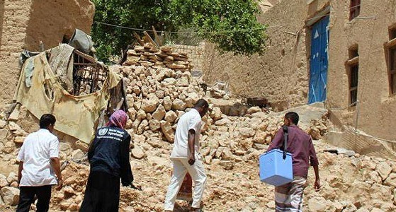
Decision Making in Public Health Emergencies
Dr. Oliver Morgan
RECON 2018
Photo: WHO/Yemen
Health
emergencies
programme

Slide 2
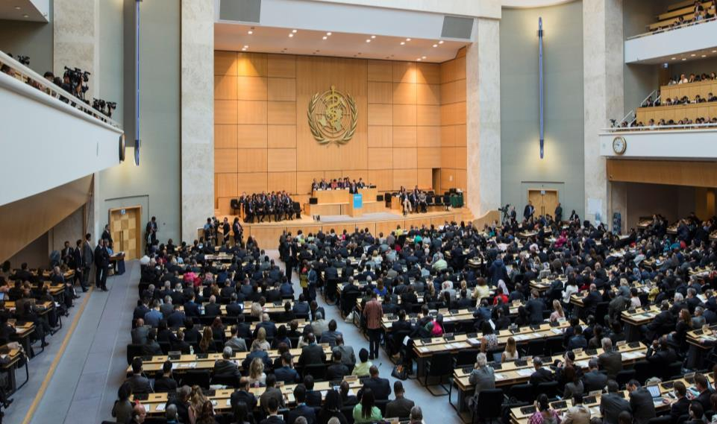
Context
69th World Health Assembly – May 2016
WHO Health Emergencies (WHE) Programme Created
Notes:
Health Emergencies Programme (WHE) created to better detect and respond to outbreaks and emergencies
Complement traditional technical and normative work
Detection of public health crises at centre of WHO activities
WHE helps countries and coordinates international action to prevent, prepare for, detect, rapidly respond to, and recover from outbreaks and emergencies.

Slide 3
WHO’s strategic priorities
Driving progress toward the SDGs
Keep the world safe
Improve health
Serve the vulnerable

Slide 4
WHE’s conceptual framework

Slide 5
How is WHE Structured
Office of the Deputy Director General
External Relations Communications
Headquarters
Regional Offices
Country Offices
R&D Blueprint
Emergency Management & Operations
AFRO
Priority 1
Infectious Hazards Management
AMRO/PAHO
Priority 2
EMRO
Priority 3
Health Emergency Information
EURO
Other
Country Preparedness & IHR
SEARO
Management and Administration
WPRO

Slide 6
How is WHE Structured
Office of the Deputy Director General
External Relations Communications
Headquarters
Regional Offices
Country Offices
R&D Blueprint
Emergency Management & Operations
AFRO
Priority 1
Infectious Hazards Management
AMRO/PAHO
Priority 2
EMRO
Priority 3
Health Emergency Information
EURO
Other
Country Preparedness & IHR
SEARO
Management and Administration
WPRO

Slide 7





Health Emergency Information and Risk Assessment
Detection
Verification
Risk Assessment
Investigate/
Respond
Reporting
Event-based surveillance
Case-based surveillance
Partner networks
Internal WHO Process
Field investigations
Field data collection
Response Monitoring
Ministries of Health
WHO Country Offices
Partners
Field Teams
IHR reporting
Disease Outbreak News
WHO Senior Leadership
Partners

Slide 8


Epidemic Intelligence
Photo: WHO/Lorenzo Pezzoli
Health
emergencies
programme

Slide 9
Epidemic Intelligence
Input
Respond
Process
Continuous Cycle
Report
Epidemic
Intelligence
Detect
Risk
Assess
Verify
Analyse

Slide 10
Epidemic Intelligence
Input
National surveillance
Event-based surveillance
Sentinel surveillance
Laboratory networks
Humanitarian data
Health service data
Research studies
Respond
Process
Continuous Cycle
Report
Epidemic
Intelligence
Detect
Risk
Assess
Verify
Analyse

Slide 11
Epidemic Intelligence
Input
Respond
Process
Preparation
De-duplication
Linkage
Geotagging
Continuous Cycle
Report
Epidemic
Intelligence
Detect
Risk
Assess
Verify
Analyse

Slide 12
Epidemic Intelligence
Input
Respond
Process
Continuous Cycle
Report
Epidemic
Intelligence
Detect
Review data
Identify signals
Establish correlations
Risk
Assess
Verify
Analyse

Slide 13
Epidemic Intelligence
Input
Respond
Process
Continuous Cycle
Report
Epidemic
Intelligence
Detect
Lab confirmation
Credible sources
Field verification
Triangulation
Risk
Assess
Verify
Analyse

Slide 14
Epidemic Intelligence
Input
Respond
Process
Continuous Cycle
Report
Epidemic
Intelligence
Detect
Risk
Assess
Verify
Gather further information
Interpret available data
Descriptive analysis
Conduct investigation
Modelling
Analyse

Slide 15
Epidemic Intelligence
Input
Respond
Process
Continuous Cycle
Report
Epidemic
Intelligence
Detect
Hazard Assessment
Exposure Assessment
Context Assessment
Risk Characterization
Risk
Assess
Verify
Analyse

Slide 16
Epidemic Intelligence
Input
Respond
Process
Continuous Cycle
Decision Support
Documentation
Visualization
Communication
Report
Epidemic
Intelligence
Detect
Risk
Assess
Verify
Analyse

Slide 17
Epidemic Intelligence
Input
Continued Observation
Operational Action
Control Measures
Interventions
Respond
Process
Continuous Cycle
Report
Epidemic
Intelligence
Detect
Risk
Assess
Verify
Analyse

Slide 18
Epidemic Intelligence
Input
Respond
Process
Continuous Cycle
CONTEXT
Stable
Report
Epidemic
Intelligence
Detect
Unstable
Risk
Assess
Verify
Analyse

Slide 19
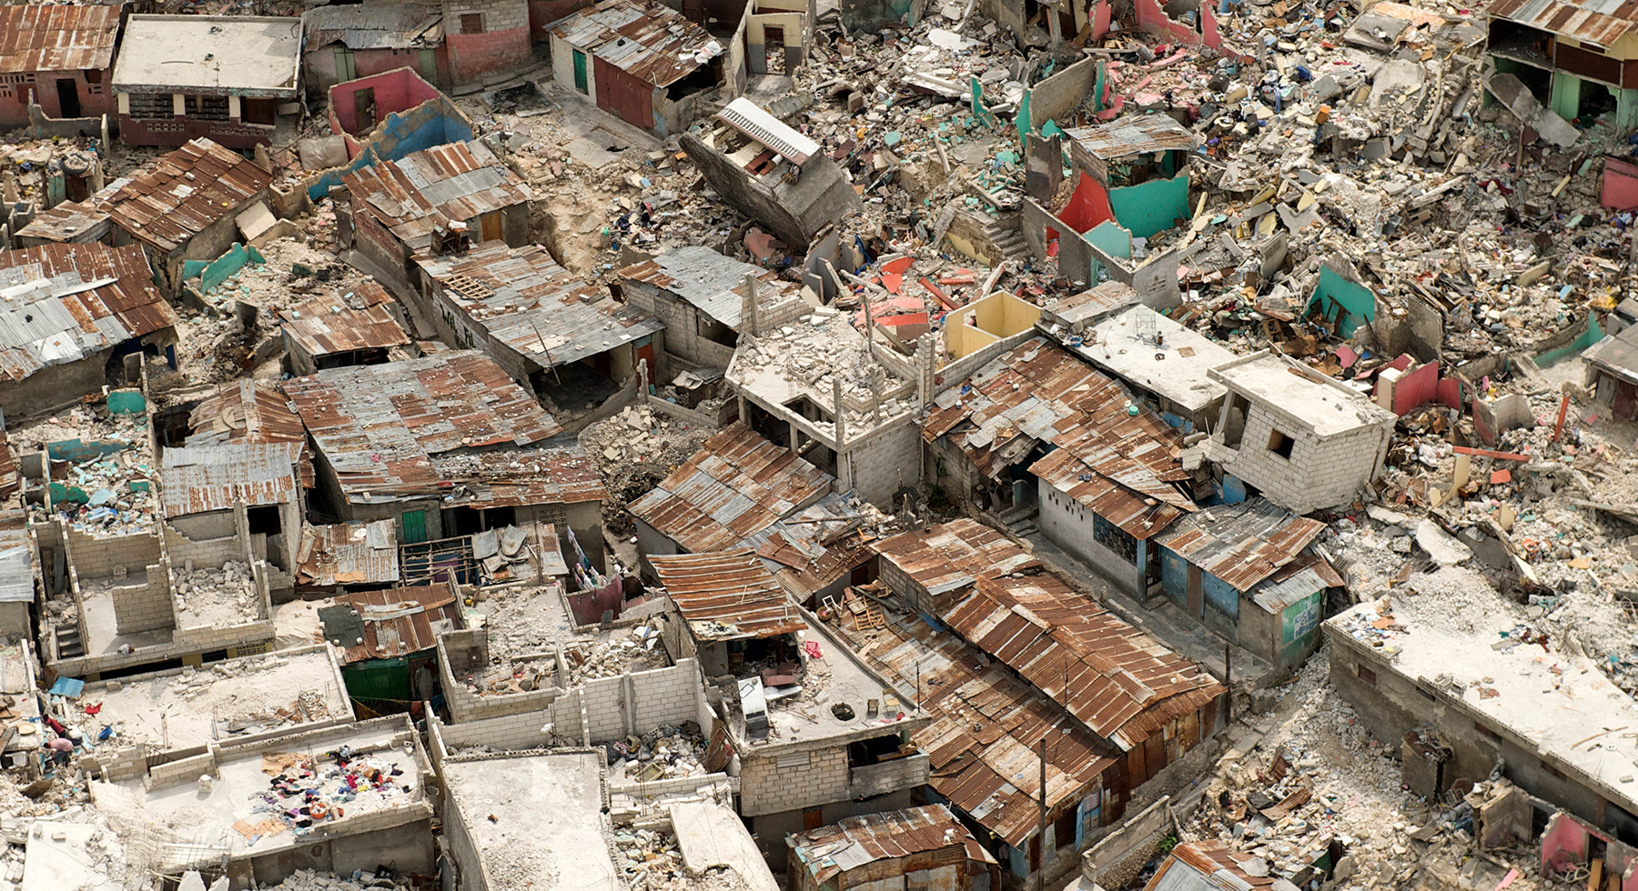
What Decisions are Needed?
Health
emergencies
programme

Slide 20
Analysis for Decision Makers in the Field
Epidemiological descriptions
Investigations of causal agents or risk factors
Needs assessments
Identifying optimal interventions
Forecasting

Slide 21
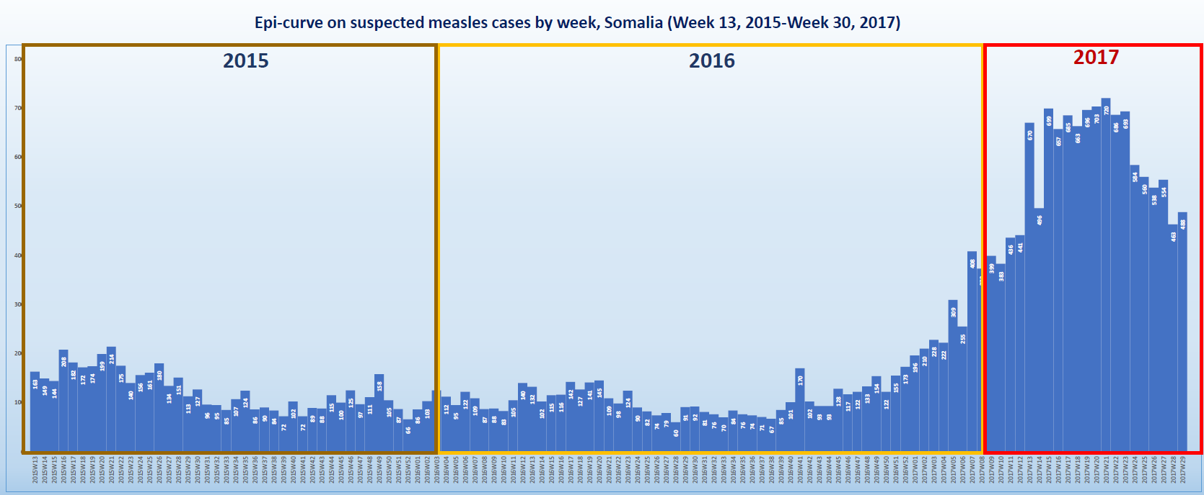
Measles in Somalia
Measles cases by Week of Onset, 23 March 2015 to 23 July 2017
80
70
60
50
40
30
20
10

Slide 22
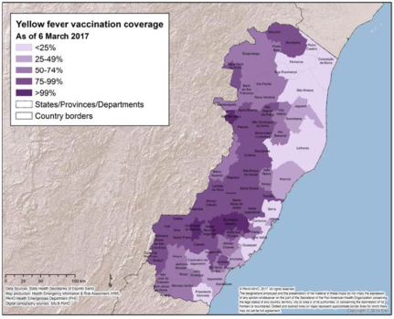
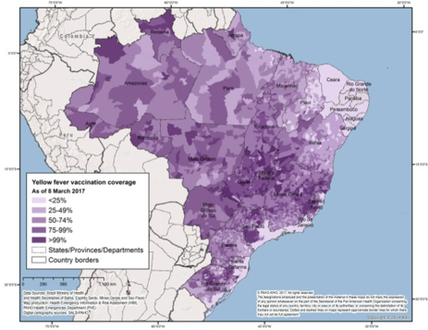
Yellow Fever in Brazil
6 March 2017
8 March 2017

Slide 23
Legionnaires` Disease, Ex-Dubai

Slide 24
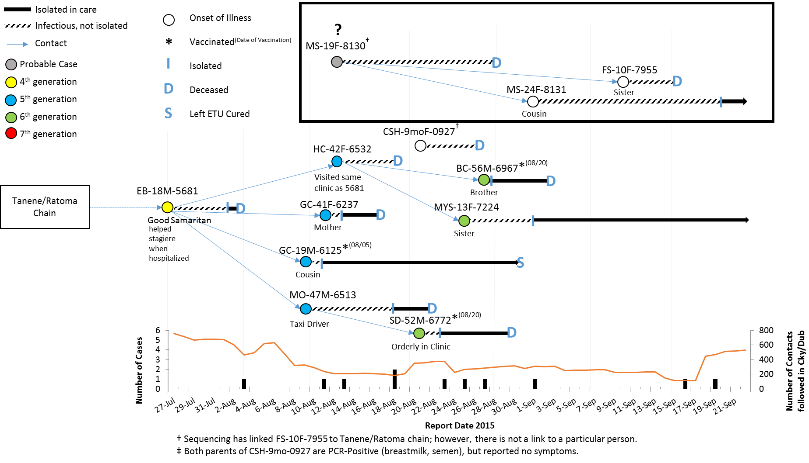
Ebola Transmission Chain, Guinea

Slide 25
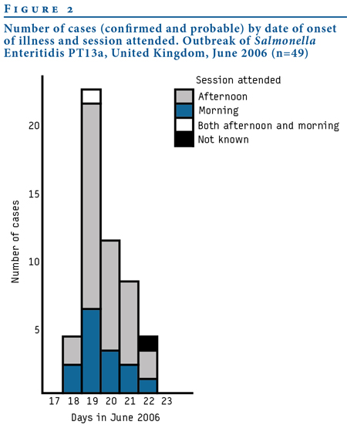
Foodborne Outbreak, England
Salmonella Enteritidis phage type (PT)13a
Eating egg mayonnaise bagels
OR=34.1, 95%CI 10.5 – 111.3
Morning | OR=11.9 | (2.7 - 52.5)
Afternoon | OR=151.6 | (15.5 - 1486.1)
Interaction p=0.04
Outbreak of Salmonella Enteritidis phage type 13a: case-control investigation in Hertsmere, United Kingdom. Euro Surveill. 2007;12(7):pii=724

Slide 26
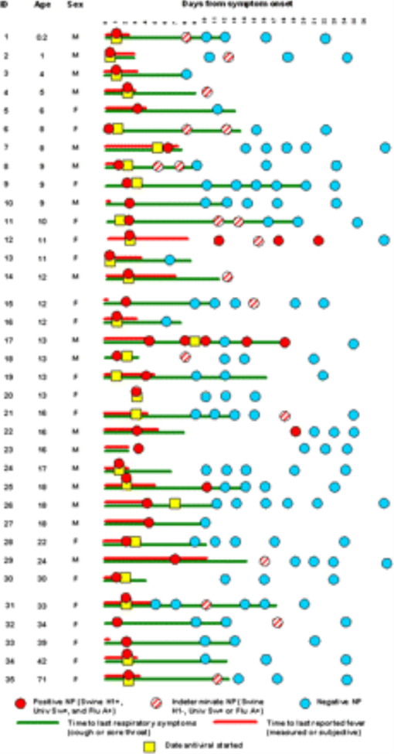
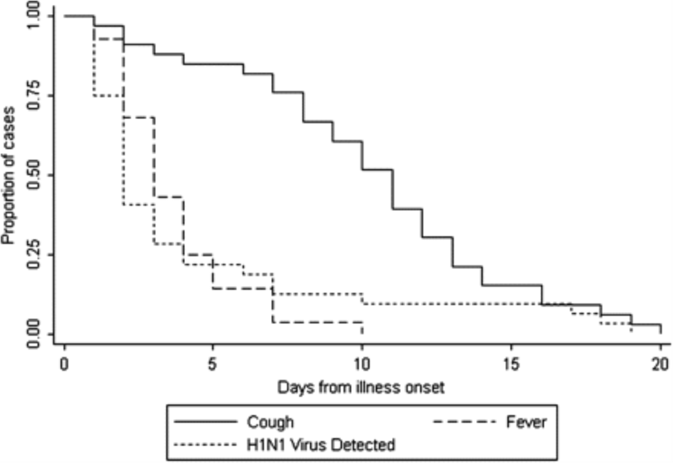
A(H1N1)pdm09, United States
Virus detection 4.2 days
duration of fever 3.5 days
Rate Ratio= 1.14 (95% CI, 0.66–1.95)
Clinical Infectious Diseases, Volume 52, Issue suppl_1, 1 January 2011, Pages S109–S115

Slide 27
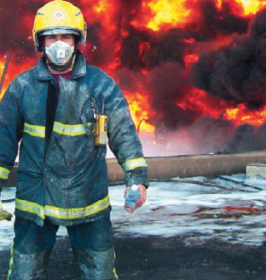
Occupational Exposure, UK
Explosion and fire at Europe`s largest oil depot
Respiratory Symptoms (N=815)
Working inside inner cordon vs. outer cordon | OR=2.07 (95% CI, 1.24 to 3.47)
Wearing a face mask vs. no mask | OR=2.33 (95%CI, 1.67 to 3.26)
Occup Environ Med. 2008 Jun;65(6):404-11

Slide 28
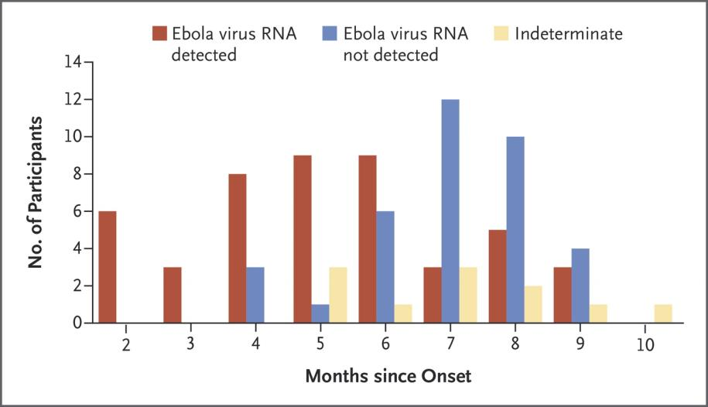
Ebola Virus Persistence in Survivors
93 participants
49% had virus detected in semen
26% at 7 to 9 months
N Engl J Med 2017; 377:1428-1437

Slide 29
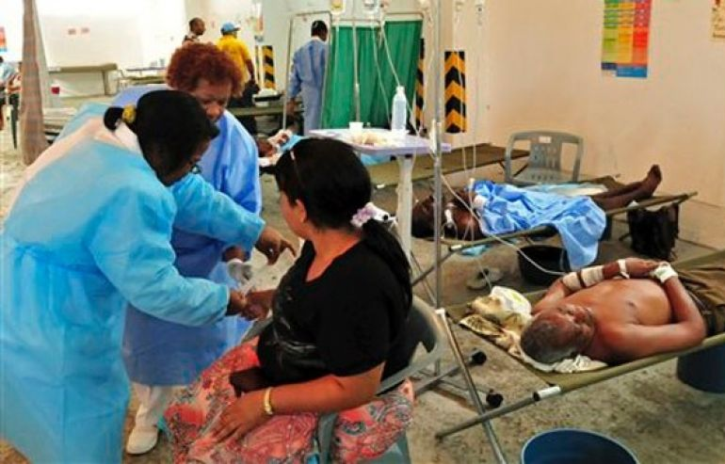
Cholera in the Dominican Republic
Objective: Assess the impact of training on cholera
233 health care workers surveyed
75% had received training
Proportion of questions answered correctly was 76% among trained workers vs. 62% for those without training
Emerging Infect Dis. 2011 Nov;17(11):2177-8

Slide 30

KAP Surveys in Sierra Leone
Question: Is Ebola caused by a virus?
Aug 2014
Oct 2014
Dec 2014

Slide 31
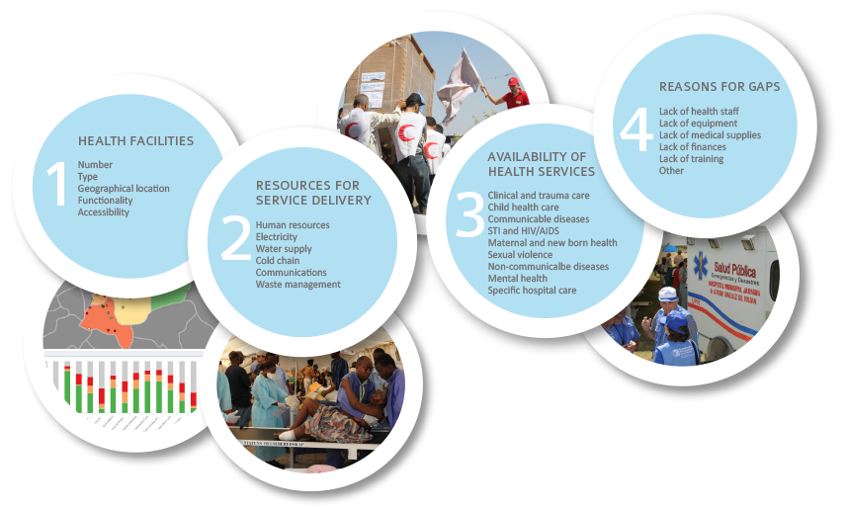
Health Resources Availability Monitoring System (HeRAMS)
HeRAMS monitors four elements:

Slide 32


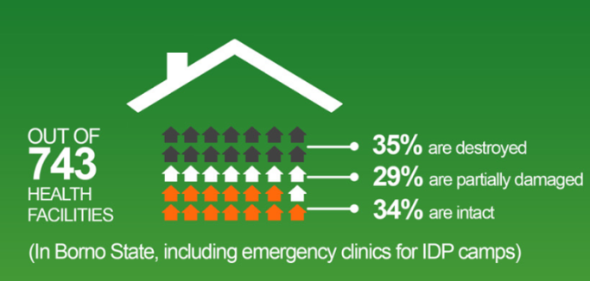
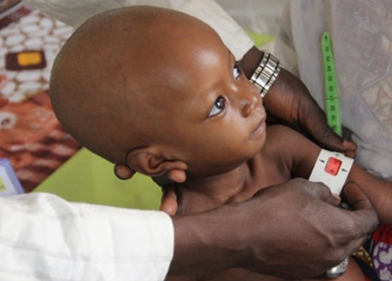
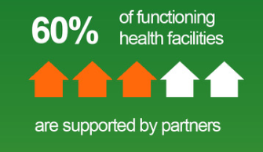
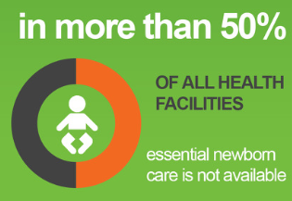
HeRAMS – Nigeria 2017

Slide 33
Better Decisions
Photo: WHO/Lorenzo Pezzoli
Health
emergencies
programme

Slide 34
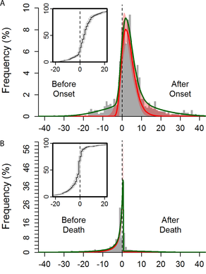
Modelling during the 2014-16 Ebola Outbreak
Observed and fitted distribution of reported time to non-funeral exposure from symptom onset and death of the contact
International Ebola Response Team, Agua-Agum J, Ariyarajah A, Aylward B, Bawo L, et al. (2016) Exposure Patterns Driving Ebola Transmission in West Africa: A Retrospective Observational Study. PLOS Medicine 13(11): e1002170. https://doi.org/10.1371/journal.pmed.1002170
http://journals.plos.org/plosmedicine/article?id=10.1371/journal.pmed.1002170

Slide 35
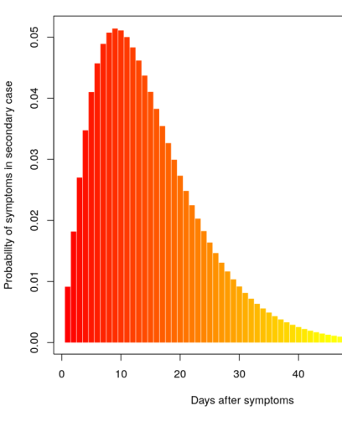
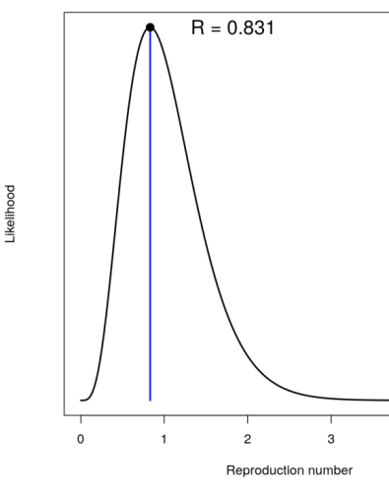
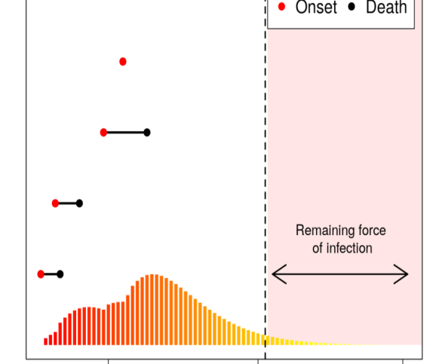
Ebola in DRC, May 2017
Serial Interval
Reproduction number
Force of Infection
Of 1,000 simulations, 82% showed no cases in next 42 days
Source: Dr. Thibaut Jombart, Imperial College London

Slide 36
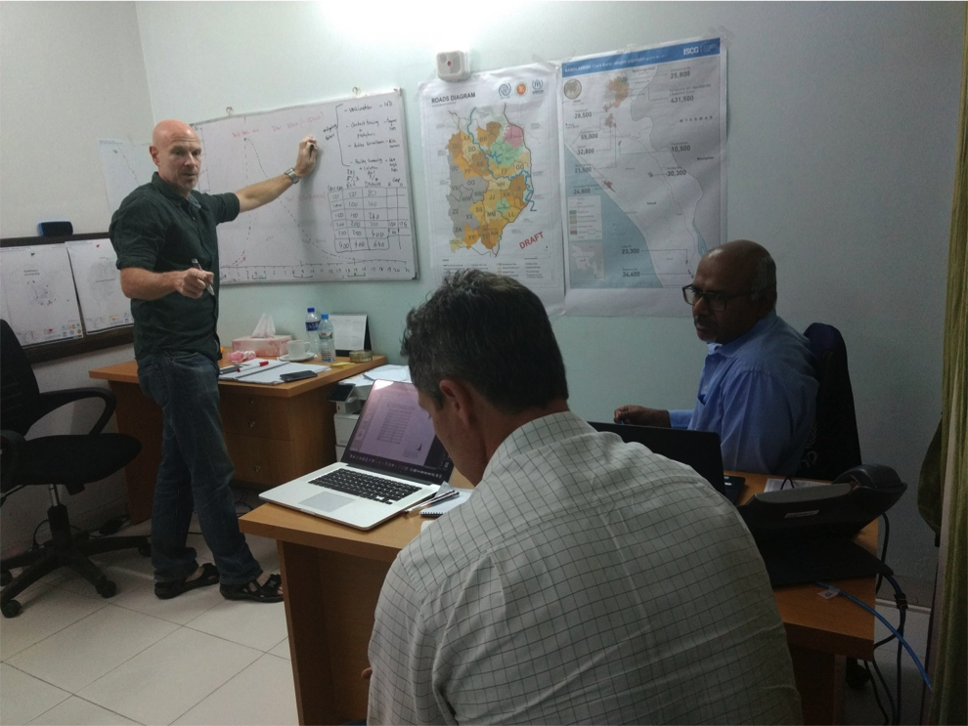
How Decisions are Often Made

Slide 37
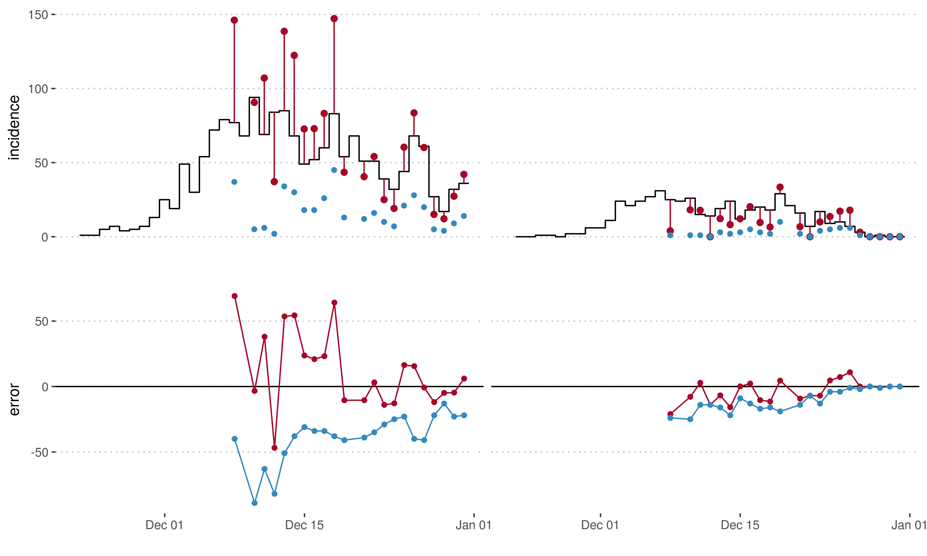
Diphtheria in Cox`s Bazar, adjusted cases – day 1
Adam Kucharski, Flavio Finger, Sebastian Funk, John Edmunds
London School of Hygiene & Tropical Medicine
Left: BMS – right: KTP
Black – reported incidence from last line-list (12.01.2018)
Blue – reported incidence according to line-list 1 day after x-axis date
Red – adjusted incidence according to line-list 1 day after x-axis date
Data: MSF

Slide 38
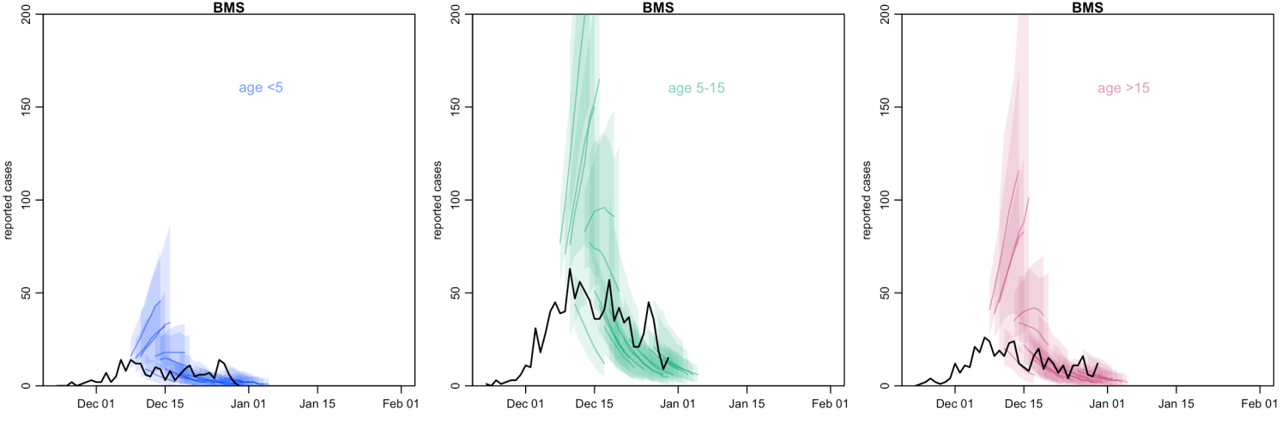
Diphtheria Forecasts in Cox`s Bazar
• Coloured lines show one week forecast for each available line list (with 95% CI)
• Black lines show data from final line list of 2017. In real-time we included a rough adjustment for likely reporting delays

Slide 39
Recommendation 13 December 2017
Excerpts of Email from Oliver Morgan to the WHO Field Team
I have drafted the note below that can be used to explain the recommendation to plan for 100 daily new cases presenting.
A) We interpret the modelled estimates from the London School of Hygiene and Tropical Medicine as an indication of the upper bound of plausible cases. There two critical assumptions in the model which might generate higher estimates.
The serial interval in the model is 4 days. From the Control of Communicable Disease Manual (20th Edition) the median infectiousness period interval is 14 days. We have no data about the serial interval for diphtheria in this outbreak or previous outbreaks, but 4 days is likely to be at the lower end of the range.
The growth rate in the model is based on adjusted case estimates, which are likely to be to the maximum upper level as the non-specific case definition that will introduce misclassification (inclusion of non-cases), leading to a growth rate that is at the higher end.
B) The number of new patients reported over the last three or four days is approximately 10% of the modelled estimates, which we consider reasonable.
C) Using the bed-estimate table below, we recommend that the team in CBX plans for 100 new cases daily, which requires 100 red bed and 160 orange beds.
D) WHO, MSF, LSHTM together will review the situation daily over the next 7 days to monitor any departure from our assumptions and recommend course corrections as necessary.

Slide 40
Recommendation 14 December 2017
Excerpts of Email from Oliver Morgan to the WHO Field Team
Based on contextual information from the field teams, we would like to review the bed requirement estimate for planning purposes.
Our revised recommendation is to plan for a caseload of 200 new patients per day.
The revised estimate takes into account that there is likely to be a sizeable proportion of patients presenting with signs and symptoms that need to be clinically managed as suspected diphtheria cases. The estimate also considers that the implementation of the vaccination campaign may take longer than initially anticipated.
I have copied the email below for your reference, in which we outline the number of true diphtheria cases that we estimate per day, but which did not take into account the need to manage a mixed caseload.

Slide 41
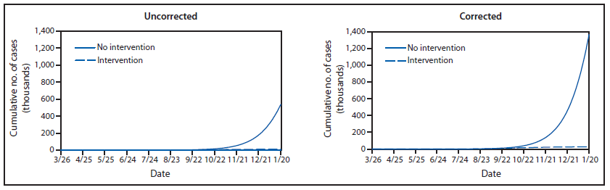
Predicting the Future
FIGURE 7. Estimated impact of interventions on cumulative number of Ebola cases, with and without corrected data*— EbolaResponse modeling tool, Liberia, 2014
Meltzer et al: MMWR; 2014 / 63(03);1-14

Slide 42
Some Reflections
Quantitative decision support is needed in the field with “real-time” interaction with decision makers
Better balance between quick/simple and slower/complex work – speed is important
Interventions/ health services just as important as epidemiology
Menu of options usually very limited
What is the appropriate role of forecasting?
Data collection guided by decision analysis objectives
Data sharing issues need to be addressed

Slide 43

Thank you
Photo: WHO/Lorenzo Pezzoli
Health
emergencies
programme

